Slide 1







ENHANCING FOOD AND GUEST OPERATIONS FOR
HAWAIIAN
FALLS
Landen Barker and Fabian Carbo Ruiz

Slide 2


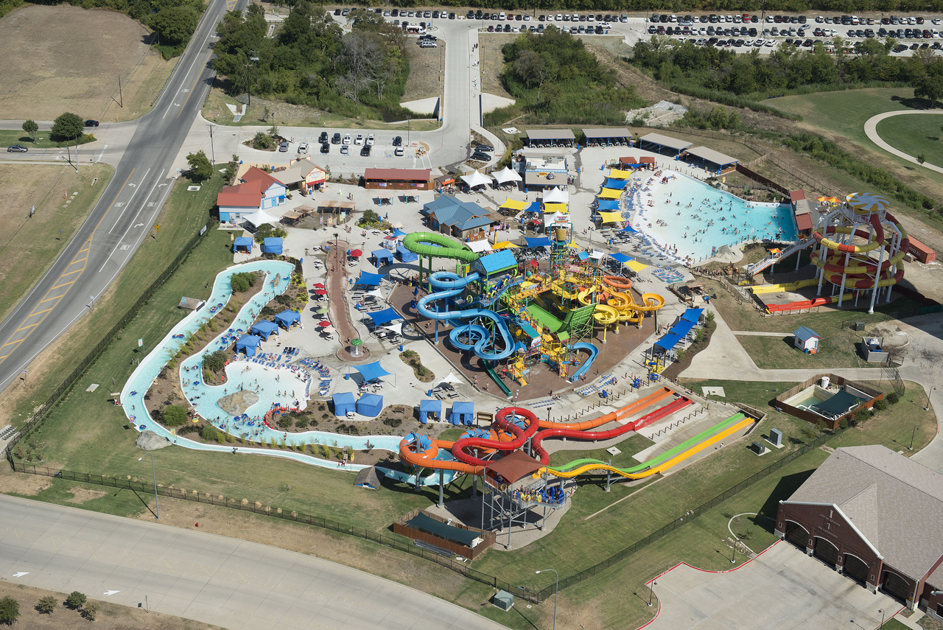
COMPANY OVERVIEW
Notes:
Hawaiian Falls LLC is a Texas-based waterpark chain focused on delivering family-friendly entertainment through water attractions, on-site dining, and summer events. Founded in 2003, its mission is:
"Bring families closer together by delivering safe, fun, and memorable summer experiences."
Primary customers include families, teens, local community groups, and summer tourists.
In 2023, Hawaiian Falls was awarded the best out of the top 20 water parks across all of Texas!

Slide 3
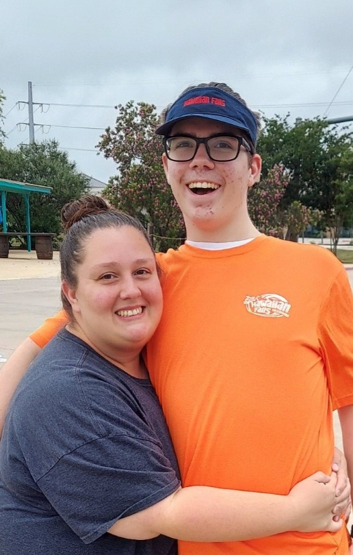
MY PERSONAL
EXPERIENCES
Notes:
I joined Hawaiian Falls in the summer of 2023, and after just 1 year of service was promoted to food and beverage manager!
It was my job to oversee all food operations within the waterpark, and work towards improving them.

Slide 4


Limited menu variety
Slow kitchen workflow
Lack of tap-to-pay and outdated POS systems
Disorganized cable setups
Inconsistent merchandising displays
Insufficient employee training
CURRENT PROBLEMS

Slide 5


INTRODUCING:
PROJECT FLOW
A multi-phase improvement plan focused on:
Expanded menu (wraps, salads, improved pizzas)
Upgraded online ordering
Tap-to-pay card reader installation
Organized and eye-level merchandising
Structured cable management
Staff training for sustainability

Slide 6
STEP 1
FOOD REVENUE
IMPROVEMENTS

Slide 7
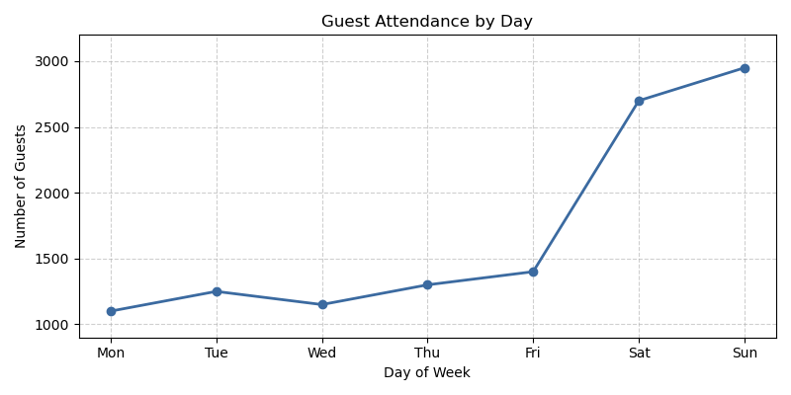
Average Food Spent per Guest (FPSG): $17
FOOD REV. PROBLEMS
Notes:
The average guest will purchase an entree, a drink, and a snack.
Daily Revenue Before Project Flow
Weekday attendance: ~ 1,200 guests
Peak weekend: ~2,800 guests
Baseline Food Revenue:
1,200 * $17 = $20,400 per day.
But this is only if EVERY guest goes to Sharkey's, not every guest wants to.
With, menu enhancements, merchandise optimizations (eye-level product placement, full coolers, etc.), and improved service efficiency are expected to increase food & beverage revenue by 8-12%.

Slide 8
UPDATED
MENU
ADULT CHEESE PIZZA: $11.99
ADULT PEPPERONI PIZZA: $12.99
KIDS CHEESE PIZZA: $7.99
KIDS PEPPERONI PIZZA: $8.99
CHEESEBURGER: $10.99
PRETZELS: $3.00
PEPPERONI PIZZA: $23.00
CHEESE PIZZA: $22.00
WRAPS: $13.00
SALADS: TBA
DRINKS: TBA
COOKIES: TBA
Notes:
The average guest will purchase an entree, a drink, and a snack.
Daily Revenue Before Project Flow
Weekday attendance: ~ 1,200 guests
Peak weekend: ~2,800 guests
Baseline Food Revenue:
1,200 * $17 = $20,400 per day.
But this is only if EVERY guest goes to Sharkey's, not every guest wants to.
With, menu enhancements, merchandise optimizations (eye-level product placement, full coolers, etc.), and improved service efficiency are expected to increase food & beverage revenue by 8-12%.

Slide 9
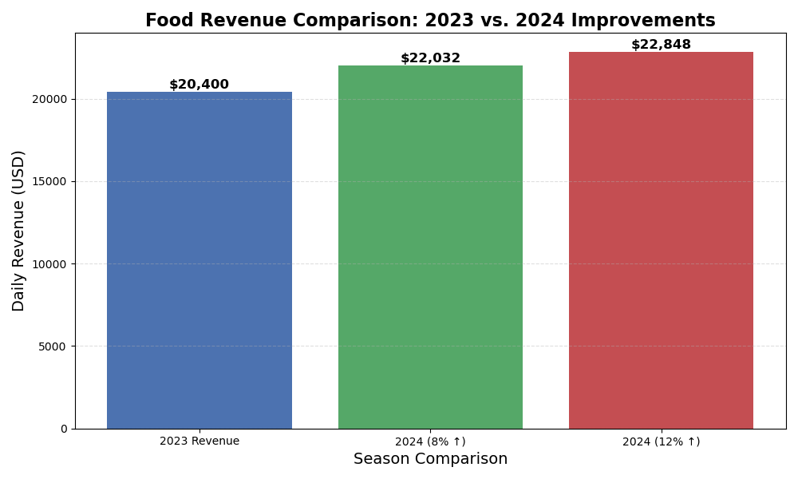
Notes:
With optimizations such as:
Improved Product Placement
More Efficient Service
Menu Enhancements
Merchandise Optimizations
We can increase our profits by 8-12%.

Slide 10
STEP 2:
POINT-OF-SALE
IMPROVEMENTS

Slide 11
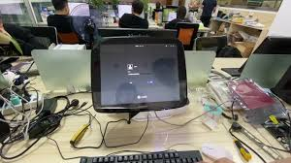
Issues
No tap-to-pay
Cable Management
Outdated OS
Requires WiFi
Notes:
Current systems take 20+ seconds for people to pay. We need a system that is faster and better.
Cable management poses serious risk to employees, there were several times I would be working and trip on a cord behind the counter.
The POS uses CentOS Linux which was deprecated in 2015. That's a little over 10 years ago!
The POS REQUIRES WiFi. No Wifi, no sales. We need a logging system that keeps track of everything locally, and re-syncs with the cloud afterwards. This way, we don't shutdown if the WiFi goes out.

Slide 12
STEP 2A:
UPDATING THE
OPERATING SYSTEM
Notes:
Current systems take 20+ seconds for people to pay. We need a system that is faster and better.
Cable management poses serious risk to employees, there were several times I would be working and trip on a cord behind the counter.
The POS uses CentOS Linux which was deprecated in 2015. That's a little over 10 years ago!
The POS REQUIRES WiFi. No Wifi, no sales. We need a logging system that keeps track of everything locally, and re-syncs with the cloud afterwards. This way, we don't shutdown if the WiFi goes out.

Slide 13

Issues
Currently Uses CentOS Linux
EOL was May, 2015
Notes:
Current systems take 20+ seconds for people to pay. We need a system that is faster and better.
Cable management poses serious risk to employees, there were several times I would be working and trip on a cord behind the counter.
The POS uses CentOS Linux which was deprecated in 2015. That's a little over 10 years ago!
The POS REQUIRES WiFi. No Wifi, no sales. We need a logging system that keeps track of everything locally, and re-syncs with the cloud afterwards. This way, we don't shutdown if the WiFi goes out.

Slide 14
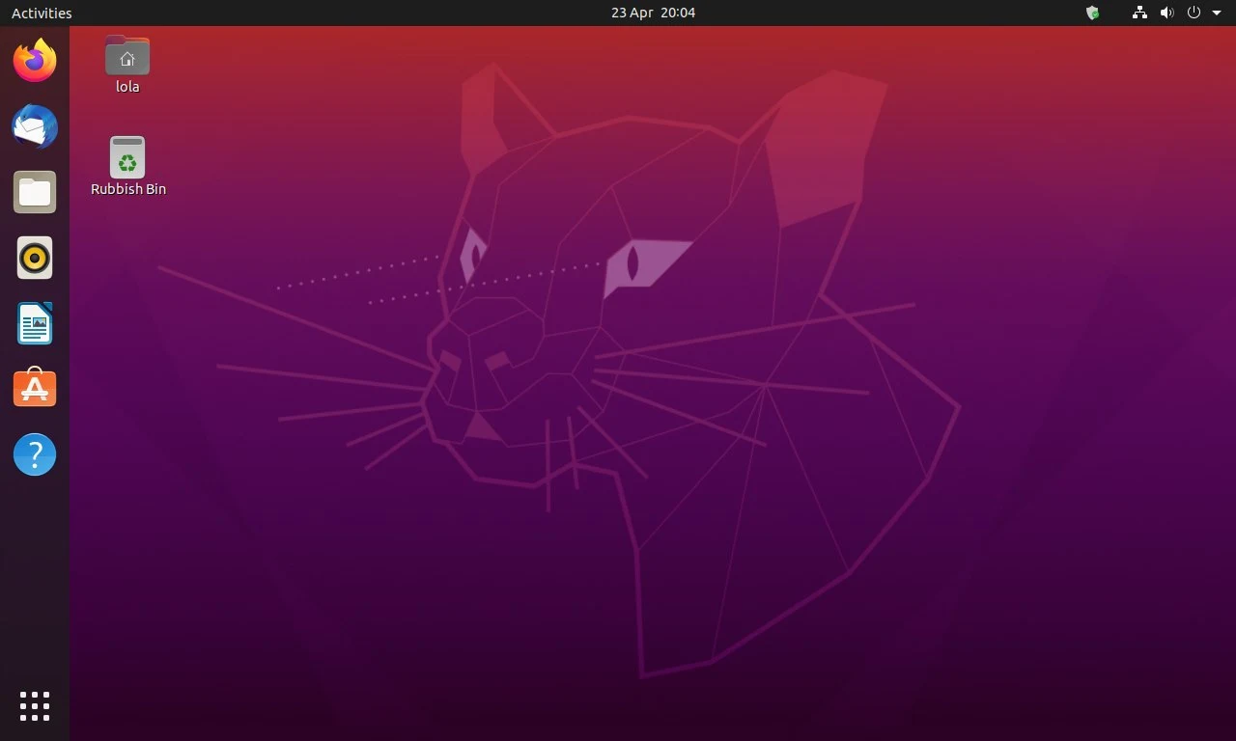
Fix
Use Ubuntu
Optimized for enterprise use
Actively updated
Last release: October, 2025
Notes:
Current systems take 20+ seconds for people to pay. We need a system that is faster and better.
Cable management poses serious risk to employees, there were several times I would be working and trip on a cord behind the counter.
The POS uses CentOS Linux which was deprecated in 2015. That's a little over 10 years ago!
The POS REQUIRES WiFi. No Wifi, no sales. We need a logging system that keeps track of everything locally, and re-syncs with the cloud afterwards. This way, we don't shutdown if the WiFi goes out.

Slide 15
STEP 2B:
PCI-DSS 4.0.1
COMPLIANCE
Notes:
Current systems take 20+ seconds for people to pay. We need a system that is faster and better.
Cable management poses serious risk to employees, there were several times I would be working and trip on a cord behind the counter.
The POS uses CentOS Linux which was deprecated in 2015. That's a little over 10 years ago!
The POS REQUIRES WiFi. No Wifi, no sales. We need a logging system that keeps track of everything locally, and re-syncs with the cloud afterwards. This way, we don't shutdown if the WiFi goes out.

Slide 16
Requirement 3.2.1
“SAD is not stored after authorization, even if encrypted.”
Even if offline, NEVER save the 3-digit CVV
Notes:
Current systems take 20+ seconds for people to pay. We need a system that is faster and better.
Cable management poses serious risk to employees, there were several times I would be working and trip on a cord behind the counter.
The POS uses CentOS Linux which was deprecated in 2015. That's a little over 10 years ago!
The POS REQUIRES WiFi. No Wifi, no sales. We need a logging system that keeps track of everything locally, and re-syncs with the cloud afterwards. This way, we don't shutdown if the WiFi goes out.

Slide 17
Requirement 3.4.1
"The PAN is rendered unreadable anywhere it is stored by using any of the following: One-way hashes... Truncation... Index tokens... [or] Strong cryptography."
The card number is properly encrypted on the tablet.
Notes:
Current systems take 20+ seconds for people to pay. We need a system that is faster and better.
Cable management poses serious risk to employees, there were several times I would be working and trip on a cord behind the counter.
The POS uses CentOS Linux which was deprecated in 2015. That's a little over 10 years ago!
The POS REQUIRES WiFi. No Wifi, no sales. We need a logging system that keeps track of everything locally, and re-syncs with the cloud afterwards. This way, we don't shutdown if the WiFi goes out.

Slide 18
Requirement 4.2
"Strong cryptography and security protocols are implemented to safeguard PAN during transmission over open, public networks."
Data must be locked before it even touches the WiFi.
Notes:
Current systems take 20+ seconds for people to pay. We need a system that is faster and better.
Cable management poses serious risk to employees, there were several times I would be working and trip on a cord behind the counter.
The POS uses CentOS Linux which was deprecated in 2015. That's a little over 10 years ago!
The POS REQUIRES WiFi. No Wifi, no sales. We need a logging system that keeps track of everything locally, and re-syncs with the cloud afterwards. This way, we don't shutdown if the WiFi goes out.

Slide 19
Requirement 9.5
"Point-of-interaction (POI) devices... are periodically inspected for evidence of tampering or replacement."
Staff check for "skimmers" every morning at the snack bar.
Notes:
Current systems take 20+ seconds for people to pay. We need a system that is faster and better.
Cable management poses serious risk to employees, there were several times I would be working and trip on a cord behind the counter.
The POS uses CentOS Linux which was deprecated in 2015. That's a little over 10 years ago!
The POS REQUIRES WiFi. No Wifi, no sales. We need a logging system that keeps track of everything locally, and re-syncs with the cloud afterwards. This way, we don't shutdown if the WiFi goes out.

Slide 20
Requirement 12.3
"A targeted risk analysis is performed for each PCI DSS requirement that the entity fulfills with a customized approach."
The park needs a plan for "declined" offline cards.
Notes:
Current systems take 20+ seconds for people to pay. We need a system that is faster and better.
Cable management poses serious risk to employees, there were several times I would be working and trip on a cord behind the counter.
The POS uses CentOS Linux which was deprecated in 2015. That's a little over 10 years ago!
The POS REQUIRES WiFi. No Wifi, no sales. We need a logging system that keeps track of everything locally, and re-syncs with the cloud afterwards. This way, we don't shutdown if the WiFi goes out.

Slide 21
WHY NOT USE
IPAD OR SQUARE?
Notes:
You may be asking yourself "Why not just upgrade to an inclusive platform that handles this automatically such as iPad or Square POS?
We wanted to minimize the amount of Capital Expenditure required, the iPad and Square POS systems may overheat in the harsh climates offered at the waterpark. The iPad also has an EOL every 7 years, requiring a hardware update periodically.
By using ubuntu we get all the features offered by Square and iPad, for no extra cost. For the features in Sqaure listed with Ubuntu, it would cost $197.99 per month. Here, it's free. The only thing we would have to check is if the card-reader uses AES or SHA256 to comply with Requirement 3.4.1 of the PCI DSS 4.0.1 standard.

Slide 22
STEP 3:
KITCHEN LAYOUT
IMPROVEMENTS

Slide 23
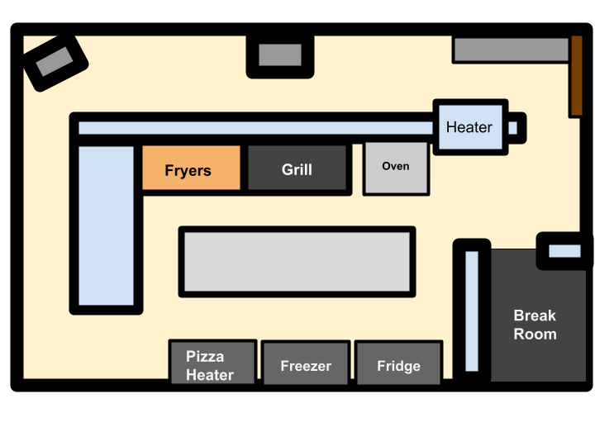
Current Kitchen Layout:
Notes:
As you can see, everything is sort of everywhere. The prep station (top right) is where people make food. Cooks work in the back, and in the front are the cashiers.
If the preps want pizza, they have to run to the back heater, past the cooks, to get it. Obstructing precious time.
If the grill operators need the fry pan, they have to yell for it, and maybe prep hears you, maybe they don't. They have to walk around the wall and past a lot of things to get the pan to the cooks.
There are also no anti-grease mats, meaning cooks could slip and fall while cooking. There is 1 heater in the wall, that is for hotdogs and pretzels, but there are no heating lamps. So food gets cold fast.

Slide 24
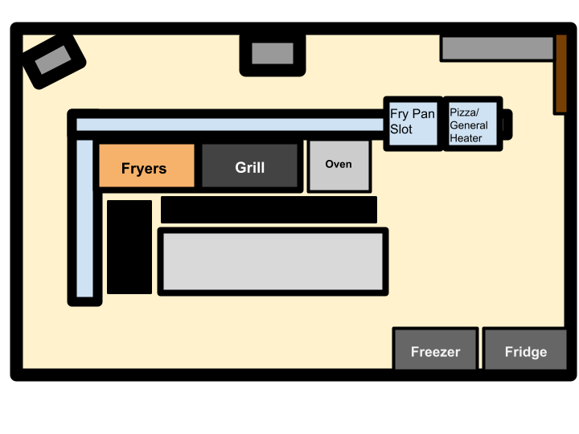
Adjusted Layout:
Notes:
This new layout lets the cooks do their thing, the preps stay in their area, and there are grease-resistant mats so nobody slips and falls. Although not drawn in, there are also heating lamps so the food stays warm while waiting. The cashiers still have access to the regular drink machines, and POS equipment.

Slide 25
RESULTS:
AFTER 2 SEASONS

Slide 26
30-40% FEWER POS OUTAGES
FASTER MORNING STARTUP TIMES
LESS MAINTENANCE COST
BETTER UPTIME DURING PEAK HOURS
LOWER STRESS FOR STAFF
GUESTS EXPERIENCES SHORTER LINES AND FEWER PAYMENT ISSUES

Slide 27
BIBLOGRAPHY
THESE GUIDELINES EXPLAIN HOW STUDENTS ARE EVALUATED, FOCUSING ON PROFESSIONALISM, PROBLEM-SOLVING, COMMUNICATION, AND INDUSTRY KNOWLEDGE. DECA’S PERFORMANCE INDICATORS DEFINE THE SKILLS COMPETITORS MUST DEMONSTRATE SUCH AS ANALYZING BUSINESS OPERATIONS, IMPROVING GUEST EXPERIENCE, RECOMMENDING OPERATIONAL IMPROVEMENTS, AND USING DATA TO SUPPORT DECISIONS.
THE COMPANY’S HEADS HELP PROVIDE DETAILS ON PARK ATTRACTIONS, FOOD OUTLETS, GUEST AMENITIES, AND OPERATIONAL FEATURES. PUBLICLY AVAILABLE INFORMATION (SUCH AS COMPANY SUMMARIES AND ONLINE REVIEWS) HIGHLIGHTS COMMON GUEST EXPERIENCES, INCLUDING FEEDBACK ON FOOD SERVICE, WAIT TIMES, AND STAFF INTERACTIONS—VALUABLE WHEN ANALYZING OPERATIONAL STRENGTHS AND WEAKNESSES.
HTTPS://CDN.PROD.WEBSITE-FILES.COM/614E10E1200F163424DDB67C/616389DA3268E3498F1593BC_PMBS_1.PDF

Slide 28
Citation Page
"Business Solutions Project Example 1." DECA Inc., n.d., cdn.prod.website-files.com/614e10e1200f163424ddb67c/616389da3268e3498f1593bc_PMBS_1.pdf.
Business Solutions Project: Family of Kidz." DECA Inc., 12 Apr. 2021, cdn.prod.website-files.com/614e10e1200f163424ddb67c/616389da3268e3498f1593bc_PMBS_1.pdf.

Slide 29
Appendix
To address these issues, this proposal recommends upgrading essential kitchen prep equipment, reorganizing the cooking and assembly layout, and implementing a streamlined inventory management process. These changes are designed to reduce wait times, improve consistency in food quality, and increase the overall speed of service during high-traffic periods. Additionally, integrating an updated POS system with options for mobile ordering and self-service kiosks will further enhance transaction speed and reduce congestion at dining locations such as Sharkey’s Café.

Slide 30
THANK YOU
www.roanoke.hfalls.com

